Slide 1
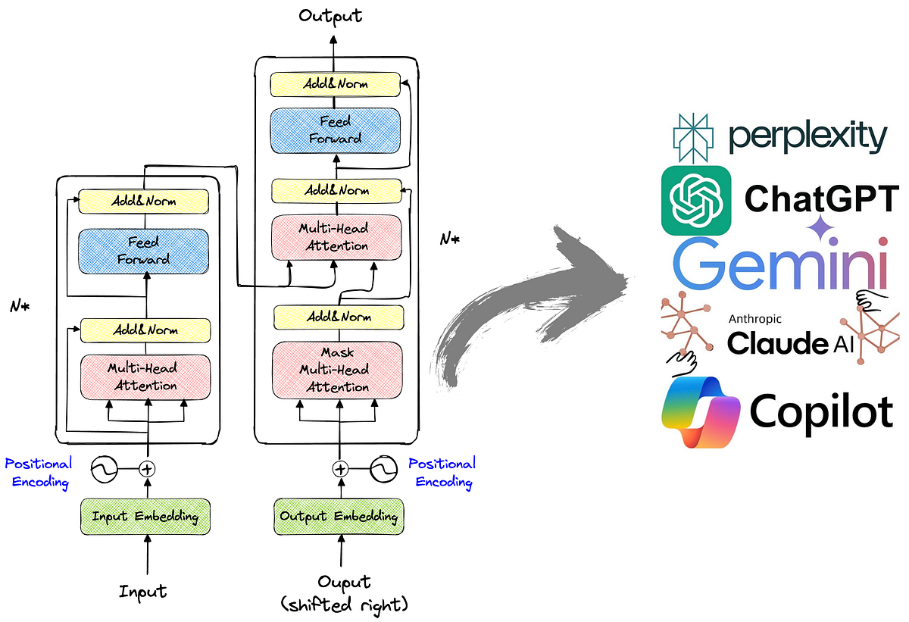
Decoder-Only Architectures: The Backbone of Modern AI
Unlike the original Transformer (Encoder-Decoder), most modern Large Language Models (LLMs) like GPT, Llama, DeepSeek, and Mistral utilize a Decoder-Only architecture.
These models are optimized for "Autoregressive" tasks, meaning they focus on generating the next word based on previous context.
By stripping the encoder, the architecture becomes highly streamlined for long-form text generation and reasoning.

Slide 2
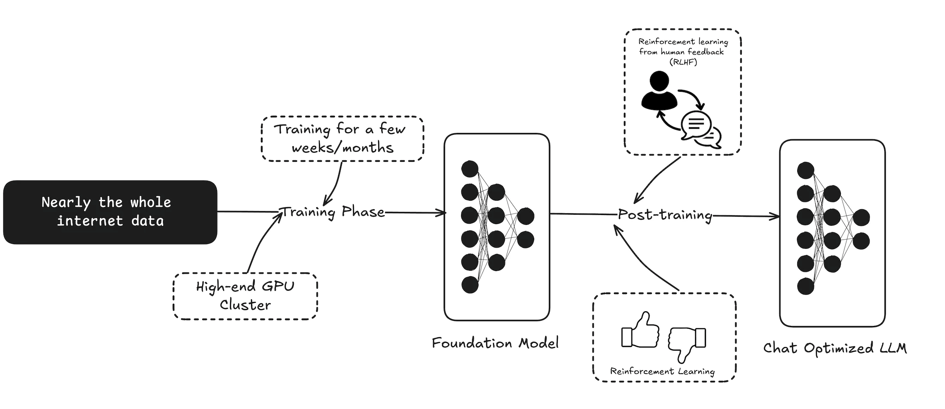
Pre-training: Learning the Knowledge of the Internet
Models are trained on massive datasets to absorb the "knowledge of the internet" during the pre-training phase.
The primary learning mechanism is Next Token Prediction, where the model guesses the next character or word in a sequence.
This allows the AI to learn grammar, facts, and logic implicitly without needing human labels for every sentence.

Slide 3
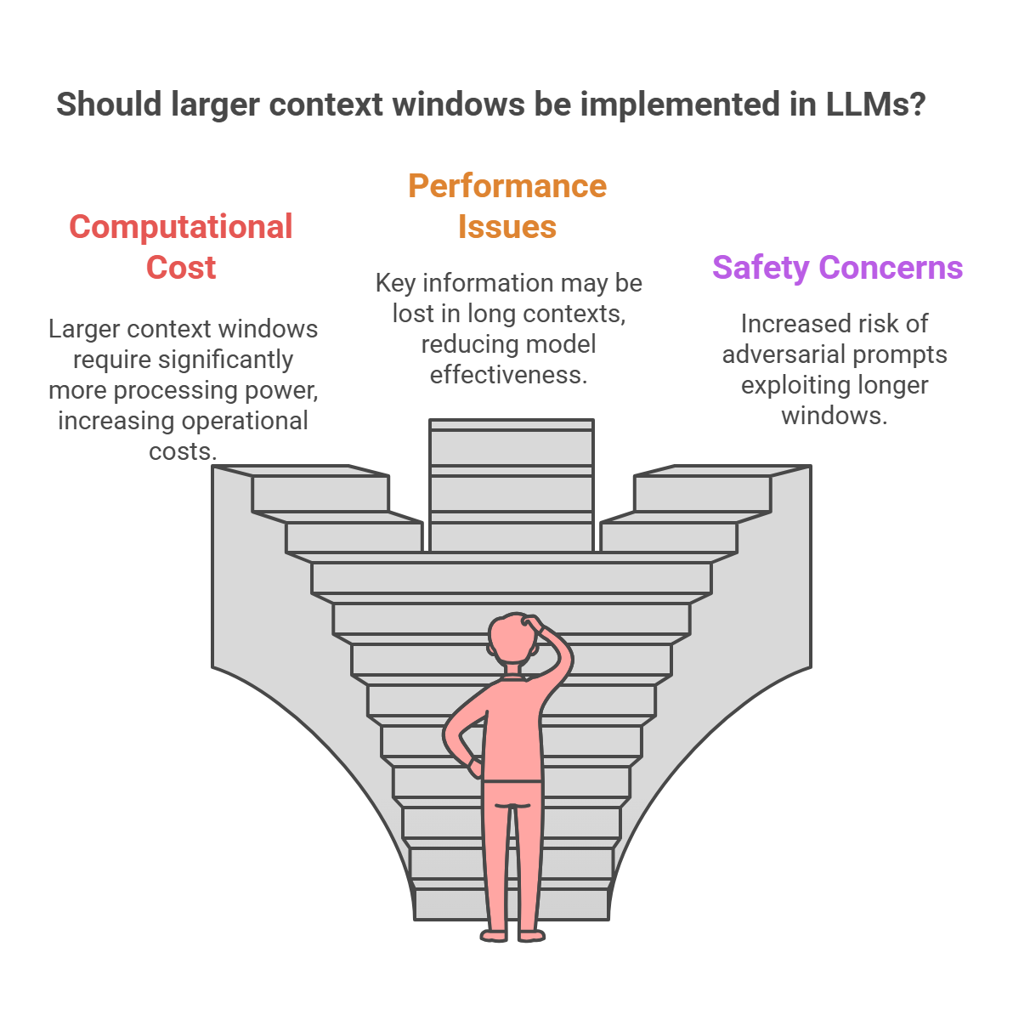
Context Windows: Understanding Memory Limits
The Context Window is the hard limit on how much text a model can "read" or hold in its memory at one time.
Information outside this window is truncated, meaning the model "forgets" the beginning of a long conversation.
Advanced engineering now pushes context windows from a few thousand tokens to millions, enabling the processing of entire books.

Slide 4

Hugging Face: The Universal AI Standard
Hugging Face Transformers is the industry-standard library for loading and using open-source models.
Pipelines: High-level tools to perform tasks like generation or summarization in very few lines of code.
AutoModel & Tokenizers: Standardized interfaces that allow users to swap different models (e.g., Mistral for Llama) without changing core code.
It supports Efficient Model Loading, such as using quantization to run large models on cheaper hardware.

